Slide 1
C37ff Finance
Time Value of Money and Net Present Value

Slide 2
Overview
Valuation: The One-Period Case
Valuation: The Multi-Period Case
Compounding Periods
Simplifications

Slide 3
Valuation:
The One-Period Case
Introducing the time value of money

Slide 4
The Time Value Of Money
Money has time value
That is, £100 receivable in two years does not have the same value as £100 now.
Generally £100 now ≠ £100 in 1 year ≠ £100 in 2 years
Therefore given the following cashflow, we cannot simply add everything up, and calculate a monetary return.

Slide 5
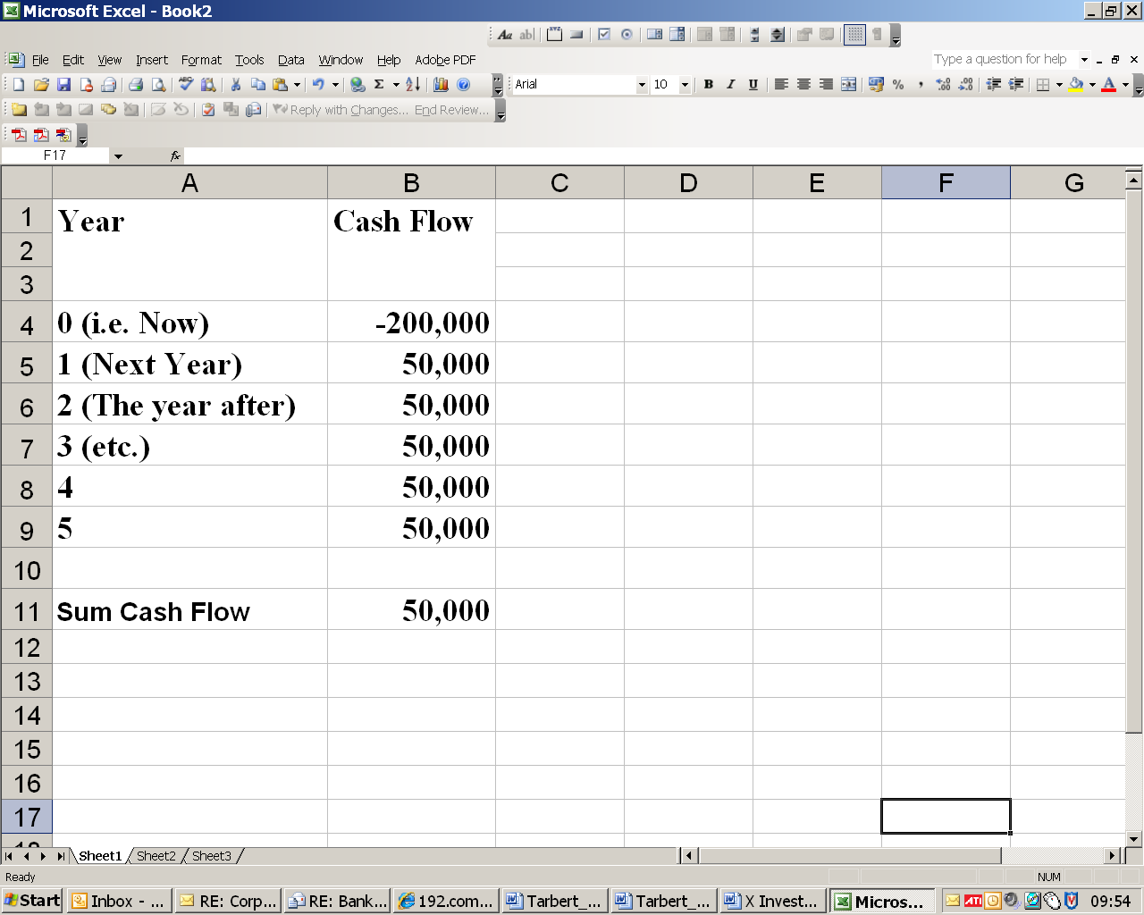
One cannot say that this project returns a net sum of +£50,000 as one cannot add unadjusted cashflow occurring at different points in time

Slide 6
The Time Value Of Money
Because a given amount of money receivable in the future does not have the same value as the same quantity receivable now
Therefore Investment Analysis requires that sums receivable at different times in the future are adjusted using discounting before they can be added together.
Discounting is the process of adjusting to a common time value.
We could adjust everything to a common point in the future
However, custom and practice is to adjust everything to year 0 equivalent
What is a future value worth in today’s £s?

Slide 7
Year Zero Equivalence
Cash flows occurring at different points of time cannot be added together.
2026 £s are not the same thing as 2025 £s are not the same as £s now.
Therefore all future cash flow must be adjusted to the present or year 0 equivalent

Slide 8
Discounting
This is done using a technique called discounting
Discounting takes a future value and converts it to a current or present value equivalent
eg If ‘now’ is 2024, and you know that you will receive £100 in 2025 what is that worth in 2024 £s?
It’s based on the idea that you have a minimum acceptable % rate of return called a discount rate.
This helps you choose whether to invest or hold on to your money

Slide 9
The Discount Rate
Discounting is based on the idea that you have a minimum acceptable % rate of return called a discount rate.
This helps you choose whether to invest or hold on to your money.
From the POV of the investor it covers time impatience, inflation and risk
From the POV it covers the % demanded by investors to provide capital
Given that your reference rate or discount rate is 12%, would you undertake the following investment?

Slide 10
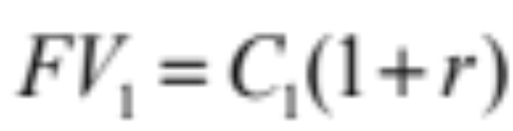
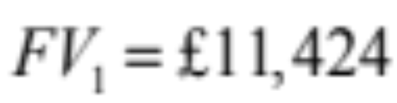

Which Cash Flow do You Prefer?
£10,000 Today
£11,424 Next Year
r = 12%

Slide 11
Convert to Year 1 Equivalents
Start with Future Value - the result of applying an interest multiple to a present value.
The present value is the sum you start off with = £10,000
The interest multiple is one plus the interest rate = 1+12% = 1.12
£11,200 = 1.12*£10,000
Your £10k now is the equivalent of £11,200 in 1 year.
But you’re being offered £11,424
Sooo….would you take this investment?

Slide 12
The Formula
£11,200 = 1.12*£10,000
Convention FV = (1+r)*C₀
FV = IM*PV
r = interest rate
FV = Future Value
IM =Interest Multiple
PV = Present Value or Initial Cash Flow

Slide 13
Future Value
By multiplying a present value by an interest multiple, today's £s become tomorrow's £s
Eg £10,000 in 2024 £s becomes £11,200 in 2025 £s provided of course that the interest rate is 12%.
Your £10,000 now is the equivalent of £11,200 in 1 year.

Slide 14
Present Value
However, it’s mor usual to convert all future values to their Year 0 equivalent or present value.
When looking at investment, we consider future cash flow.
We translate future £s back to £s now by dividing by the appropriate interest multiple.

Slide 15
The Formula
£10,000 = 11,200/1.12
Convention C₀ =FV/(1+r)
PV = FV/IM
r = interest rate
FV = Future Value
IM =Interest Multiple
PV = Present Value or Initial Cash Flow

Slide 16
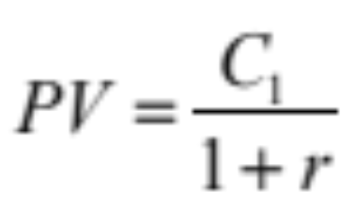
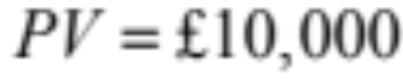
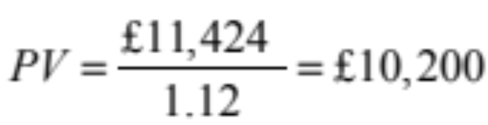
Which Cash Flow do You Prefer?
£10,000 Today
£11,424 Next Year
r = 12%

Slide 17
Learning Activity
Let’s remind ourselves. Why does money have a time value and what does this imply for investment cash flows?

Slide 18
Present Value
The reason why this is done is to compensate for
Time Value – Ii.e. impatience to have money now rather than later
Inflation
Risk – Will the expected sum actually materialise

Slide 19
Present Value
So to convert a future value to a present value, you divide the future value by an interest multiple.
You need to start of course with an interest rate known in this context as a discount rate.
Your discount rate reflects time, risk and inflation
From the firm's POV it is the % cost of capital

Slide 20
Present Value
In the example above you are asked to choose between £11,200 OR £11,420 in year one.
If your discount rate is 12%, the present value or year 0 equivalents are
£11,200/1.12 = £10,000
£11,420/1.12 = £10,200

Slide 21
Discounting to Year 0
So £11,420 in year 1 £s is worth £10,200 in £s now
This is better than £10,000
Provided of course your discount rate is 12%
Learning Activity - Would £11,420 in one year still be better than £10,000 now if the discount rate was 100%?

Slide 22
A method for analysing investment
You put in £10,000, you get back £11,420 in one year.
Provided your reference rate was 12%, you would go ahead, as you are clearly getting a bit more than 12%

Slide 23
Net Present Value
A present value is any year zero equivalent of a future value, I.e. its discounted value.
Net present value is the sum of all discounted future CF minus any initial investment

Slide 24
Net Present Value
NPV = C₀ + C₁ /(1+r)
C₀ is CF in year 0 (now). Aka Present Value. This is negative as it’s outgoing, not incoming.
C₁ is the expected CF one year ahead
(1+r) is the interest multiple
NPV = -£10000 + £11,420/1.12 = £200
Firm would go ahead with this project
NPV is positive

Slide 25
Net Present Value
NPV = -£10000 + £11,420/1.12 = £200
Firm would go ahead with this project
NPV is positive

Slide 26
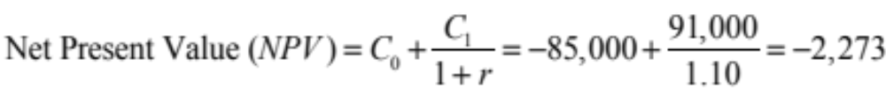
Valuation: The One-Period Case
Does a Potential Investment Add Value?
A piece of land costs €85,000. Next year the land will be worth €91,000, a sure €6,000 gain. Given that the guaranteed interest rate in the bank is 10 per cent, should you undertake the investment?

Slide 27
Net Present Value
NPV = C₀ + C₁ /(1+r)
Note that in this second example, the discount rate is 10% and the interest multiple IM or (1+r) is 1.1
NPV = -£85,0000 + £91,0000/1.1 = -£2,273
Firm would NOT go ahead with this project
NPV is negative

Slide 28
Decision Rule
If capital is not limited, accept all projects where NPV ≥ 0
If capital is 'rationed', then rank projects by NPV.
NPV is fundamental to valuation.
Eg The value of the firm can be seen as the discounted sum of it future cash flows.

Slide 29
Valuation:
The Multi-Period Case
Time value of money over many periods

Slide 30
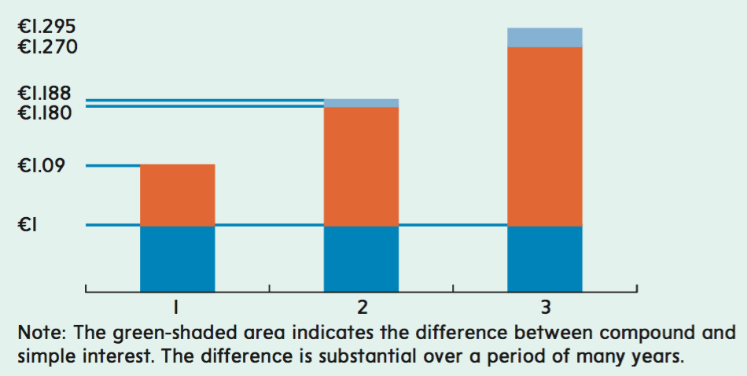
Valuation: The Multi-Period Case
Compound Interest
Simple Interest
Original Amount

Slide 31
Valuation: The Multi-Period Case
Generalised Formula for Cash Flow Future Value
FV_{T} = C₀ × (1 + r)^{T}

Slide 32
Valuation: The Multi-Period Case
Generalised Formula for Cash Flow Present Value
PV₀ = C_{T}/(1 + r)^{T}

Slide 33
Compound Interest
Suppose you start with £100 now.
Then you get 10% interest after a year
You have £110 at the start of year 1
Now suppose you get another 10% interest
Your £110 would be £121 by the start of year 2.

Slide 34
Compound interest
i.e. £121 = 110*1.1 = 1.1*1.1*£100
In other words the interest multiple, is applied twice. £121 = 1.1²*£100
This is compound interest – which is interest paid on top of previously accumulated interest
1.1² is the compound interest multiple over 2 periods

Slide 35
Compound Interest
If you applied the multiple of 1.1.again
i.e. £133.1 = 121*1.1 = 1.1*1.1*1.1*£100
In other words the interest multiple, is applied three times.
£133.1 = 1.1³*£100
1.1³ is the compound interest multiple over 3 periods

Slide 36
To put it more simply
FV_{T} = IM^{T}*PV
FV_{T} = Future value in T years
IM^{T} = Compound Interest Multiple
(Basic IM compounded T times)
PV = Present Value – i.e. The value you start with in Year 0 (Now)

Slide 37
To simplify
To find the year 0 equivalent of a future CF
Divide the CF by the appropriate compound interest multiple
Learning Activity - Suppose you expect to receive £110 in one year and £121 in two years.
What are the present values if r = 10%?
What is the NPV if you pay £100 for this investment now?
What is the NPV at r=0, r=5% and r=100%?

Slide 38
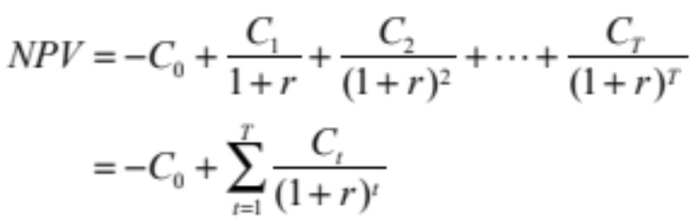
The Case of More than One Cash Flow

Slide 39
Present value of £1 receivable at various times in the future, assuming an annual financing cost of 20%
100
£1
90
Pence
80
70
60
50
40
30
20
10
0
1
2
3
4
5
6
7
8
9
10
Years into the future

Slide 40
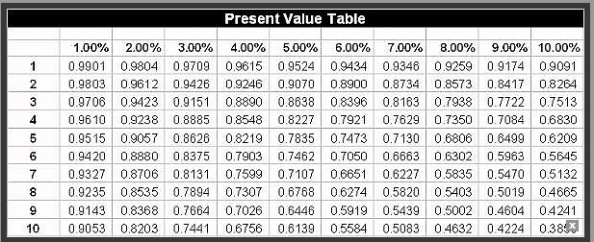
Present Value Tables

Slide 41
Incremental cash flow
When deciding as what counts as cash flow there are a few rules such as
You don’t count sunk cost
But you do include any opportunity cost.
Reported net income on the company accounts may bear little relation to actual cash flow
However, it is possible to adjust.
https://www.investopedia.com/terms/c/cfat.asp

